Slide 1
JavaScript Events

Slide 2
What are Events?

Slide 3
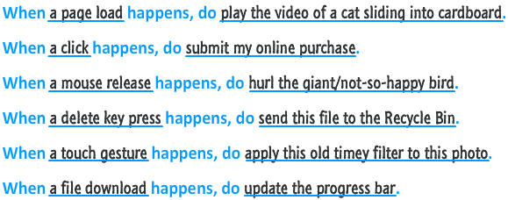
EXAMPLES OF EVENTS

Slide 4
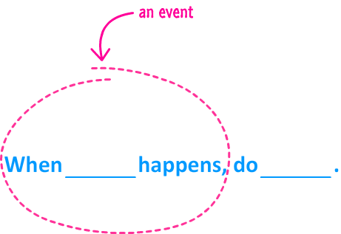
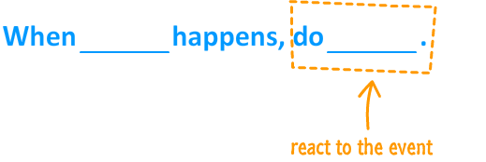

Slide 5
Events
An event is a signal.
It communicates that something has just happened. This could be a
mouse click
a key press on the keyboard
a window getting resized.
a document simply getting loaded
Events define the thing that happens. They fire the signal.
The second part of the model is defined by the reaction to the event

Slide 6
Javascript Events
To work with events, there are two things you need to do:
Listen for events
inline model
traditional model
W3C model
React to events

Slide 7
Inline Model
<body>
<input type="button" id="askme" value="Ask me" onclick="ask()"/>
<script>
function ask(){
var a =window.prompt("Please ask a question")
alert("I am sorry I don't know the answer")
}
</script>
</body>

Slide 8
Traditional Model
<body>
<input type="button" id="askme" value="Ask me"/>
<script>
var a=document.getElementById("askme");
a.onclick=ask;
function ask(){
var a =window.prompt("Please ask a question")
alert("I am sorry I don't know the answer")
</script>
</body>

Slide 9
W3C Model
<body>
<input type="button" id="askme" value="Ask me" />
<script>
var a=document.getElementById("askme");
a.addEventListener("click",ask,false)
function ask(){
var a =window.prompt("Please ask a question")
alert("I am sorry I don't know the answer")
}
</script>
</body>

Slide 10
Common Events
Event | Event is fired...
click | ...when you press down and release the primary mouse button / trackpad /
mousemove | ...whenever your mouse cursor moves
mouseover | ...when you move the mouse cursor over an element. This is the event you would use for detecting a hover!
mouseout | ...when your mouse cursor moves outside the boundaries of an element.
dblclick | ...when you quickly click twice.
load | ...when your entire document (DOM, external stuff like images, scripts, etc.) have fully loaded.
keydown | ...when you press down on a key on your keyboard
keyup | ...when you release a key press on your keyboard
scroll | ...when an element is scrolled around

Slide 11
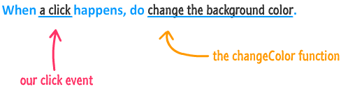

Slide 12
Event
Event Handler
Functions that handle events
Registering Events
Assign an event handler to a DOM node

Slide 13
onmouseover , onmouseout,Onmousemove
When the mouse cursor enters an element, an onmouseover event occurs for that element
When the mouse cursor leaves the element, an onmouseout event occurs for that element
onmousemove event fires whenever the user moves the mouse

Slide 14
event Object & this
event object stores information about the event that called the event-handling function
In an event-handling function, this refers to the DOM object on which the event occurred
this keyword enables one event handler to apply a change to one of many DOM elements, depending on which one received the event

Slide 15
event Object Properties

